Slide 1
Artificial Intelligence- Ongoing Progress

Slide 2
Overview
Topics to cover:
A* Algorithms
Behavioral Trees (BTs)
World Triggers (Scripting)
FSM
HSSM

Slide 3
Tidbits of information
Unlike Physics or Math,
The concepts presented here are still the source of much conjecture within the gaming industry. Since this is still a new field, this is constantly under development as such all of the topics covered should be used as a reference, and not necessarily a bible of sorts to conduct your work.

Slide 4
Topic #1…..joy
A* Algorithms
Greedy Algorithm
Used to find the best overall option
More in the realm of optimization.

Slide 5
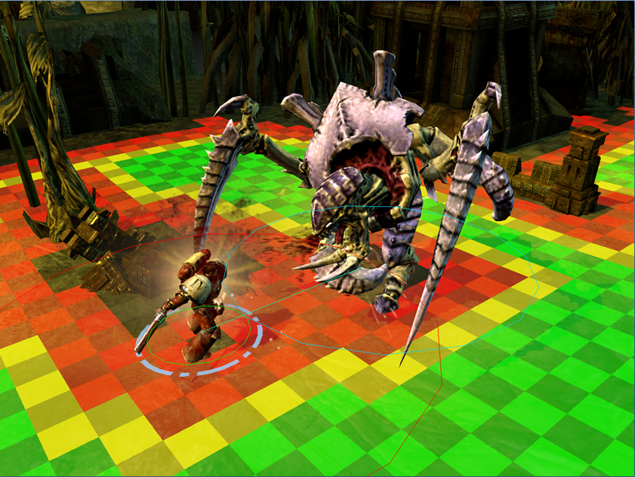
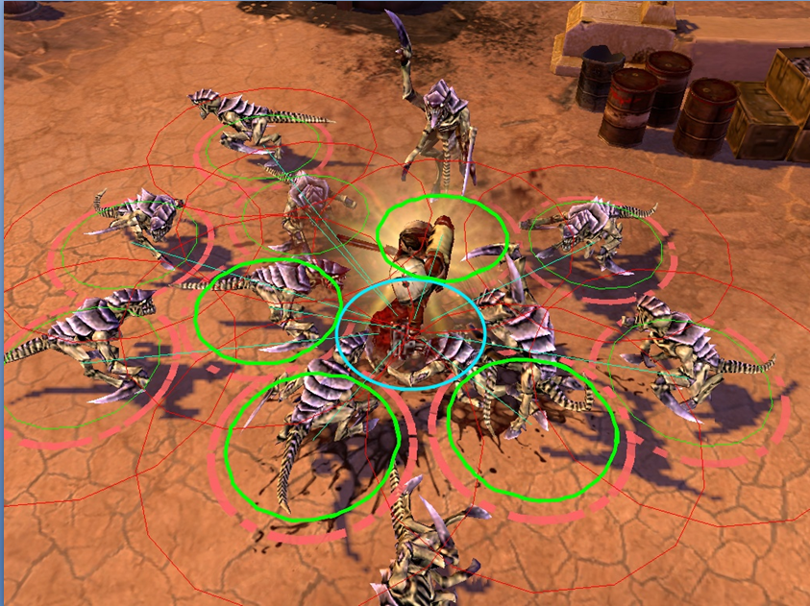
As seen in the images to the right…the game Dawn of War2.
They used A* as a means of allowing the optimal number of base to base contacts.
Based their circular “bases” off the tabletop game DoW is based off.
Won’t allow multiple enemies to attack a single target if their bases overlap.
They coined this method as Searched-Based Melee.

Slide 6
Topic…2?
Behavioral Trees (BTs)
Priority
Child nodes are evaluated in order until one validates
Sequential
First child is validated and executed
When it is finished, the next one is validated
Stochastic
All children are validated
A random node is selected among the valid ones

Slide 8
Wall of Text Time…
Behavior trees are all about flexibility
Selector choice!
Reusable goals!
Rapid iteration is a key goal
Bigger games, more actors, individualized behaviors
Need to quickly change in response to prototyping and play test
Very Lua friendly idea
Scripting is a must to allow for creating of these behavioral trees.
Have designers write these coders work in the C++ side let designers design the frontend with lua to make the behaviors they want
Perk to that---Designers can test w/o need to rebuild can even flush scripts during a single test and re-implement others to try
Keep script fast
Limit your lua to integer math, keep it basic in implementation
Limit scripting to basic actions, No ai loops, no triggering in scripts, anything "complicated enough" do it in code

Slide 9
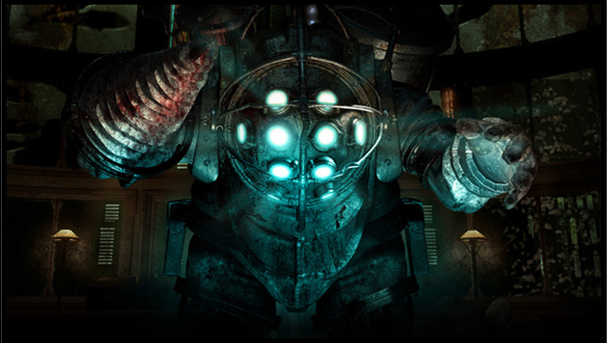
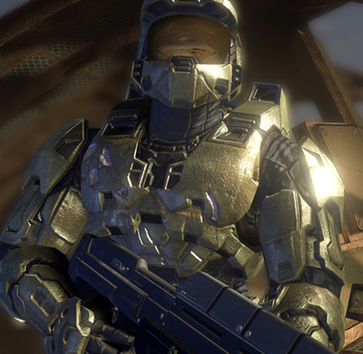
Some Games that use this Styling
Halo 3 & ODST
[PROTOTYPE]
Spore
GTA: Chinatown Wars
The Bourne Conspiracy
SWAT 4, Bioshock
Dark Sector

Slide 10
Topic…no one reads this
World Triggers (Scripting)
Hello Valve…..
We’ve seen this before…
We’ve seen this guy
before…

Slide 11
The Goals
Get the user to believe that the interactions with the AI’s is genuine.
The Ai is only acting one way with minor variations.
By coercing the player to do it a certain way you pigeonhole them into playing along with your story.

Slide 12
Reigning it back in.. #4
Finite State Machines (FSM)
Lots of the groups speaking had this general feeling:
FSM's are "antiquated", but they have certain advantages
–understandable with very modest training (mastery is a different story)
–deterministic behavior
–speedy (to execute)
–integrates easily with other game systems
•Disadvantages
–number of states can explode when handling asynchronous sequences or slightly different situations
–"stiff" and predictable agent behavior(these first two are inversely correlated)
–may have trouble scaling to complex characters/situations
–explicit coding of new state selection routines can get rough and can burn lots and lots of CPU (and development) time

Slide 13
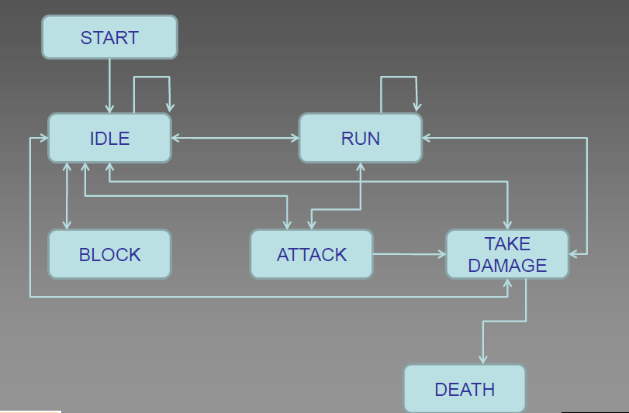
Simple FSM Diagram

Slide 14
Almost at the End… Topic 5
Hierarchical Scripted State Machines (HSSM)- essentially the spiritual successor to the FSM as far as AI routines are concerned.
Take the difficulty out of generating gigantic trees of information and create a clean means to visualize it.
Next slide to see a large arbitrary Example…..

Slide 15
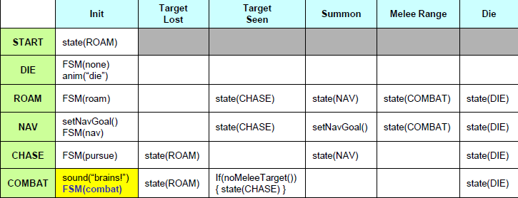
HSSM Visual Example

Slide 16
This Concludes Boring Part….
On to Greener Pastures..
Some Example form the Past and Present of well done AI’s along with their drawbacks.
Now In order of their creation… the DukeBot

Slide 17
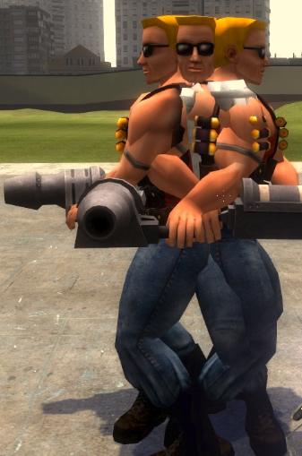
DukeBot
Worked off of Path nodes in the level, when it saw the player it would proceed to shoot at them until dead.
Great: provided a challenge
Bad: higher levels, it border line cheated.

Slide 18
EraserBot (Quake)
By and far probably the most advance AI in an FPs even by today’s standards.(IMHO)
Created its out path node system procedurally for each host. Saved its own weights in a text based file.
Given enough time it would eventually beat anyone.
Bad:
It was very costly to run more than 2-3 at the time given restrictions of hardware.

Slide 19
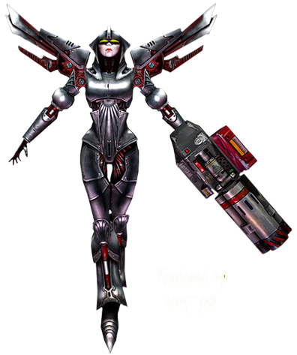
God Bots (UnrealTournament series)
PathNode based AI
Good:
Extremely challenging
Split second response to player actions
Adept at owning “pattern-players”
Bad:
Had a huge weakness on some maps.
If you could break Line Of Sight they would force revert into their Roam state rendering them defenseless if you can hit them around a curved hallway or ambush point.

Slide 20
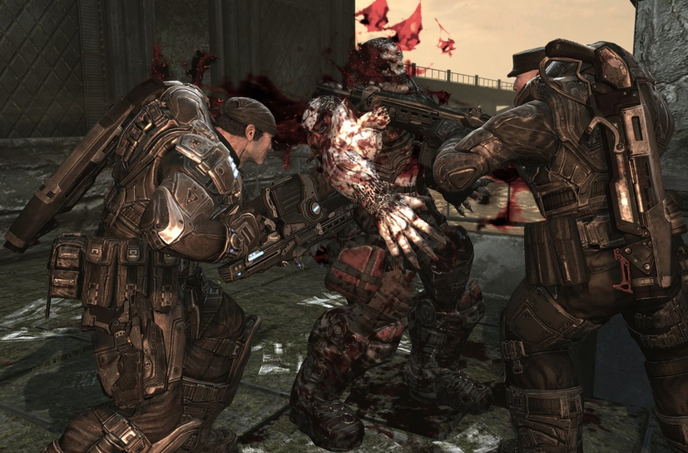
Generic Cover AI (Most Current Games)
These AI will spawn into the area, they will take up a cover position at pre-designated points.
Good:
Give the impression of greater intelligence by taking cover against player.
Bad:
Dumb as nails if you approach from beyond their LoS and attack them on a flank.

Slide 21
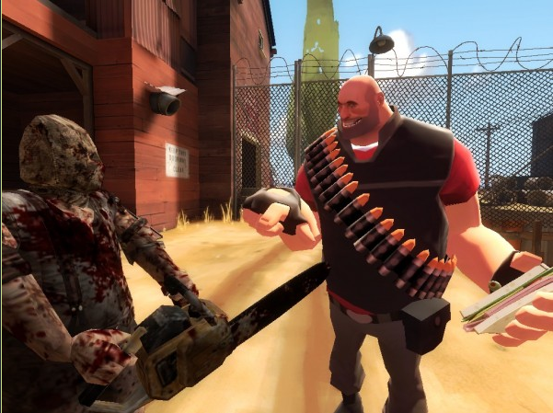
Questions?
Comments?
Witty Retorts?

Slide 22
Bibliography
A*Algorithm: http://en.wikipedia.org/wiki/A*_search_algorithm
AI Dev- AiSummit Highlights: http://aigamedev.com/open/coverage/gdc10-slides-highlights/
FSM+HSSM info: http://files.aigamedev.com/coverage/GDC10_HfsmSystem.pdf
Images courtesy of www.google.com

